Slide 1
Generating Database and Display files from Spreadsheets
Kay Kasemir
July 2026

Slide 2
Scenario
You have a lists of 200+ PLC tags
Spreadsheet, text file, …
→ Generate *.db that reads these tags
→ Generate display file that shows them all
List of tags
*.db
Display

Slide 3
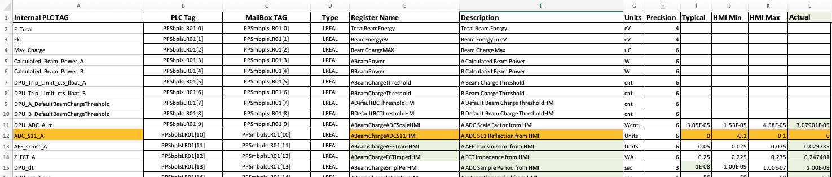
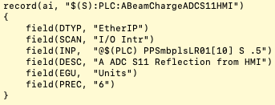
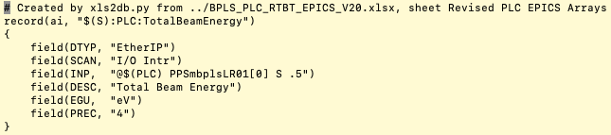
Example Spreadsheet

Slide 4
Need to agree on Columns and their Usage
PLC programmer may have started Spreadsheet as signal list helper
Register Name will be used in record name
  → No spaces!
Type determines record type
Mailbox TAG will be used for INP
Description, Units, Precision will be used for DESC, EGU, PREC
Colors, fonts, anything else is ignored

Slide 5
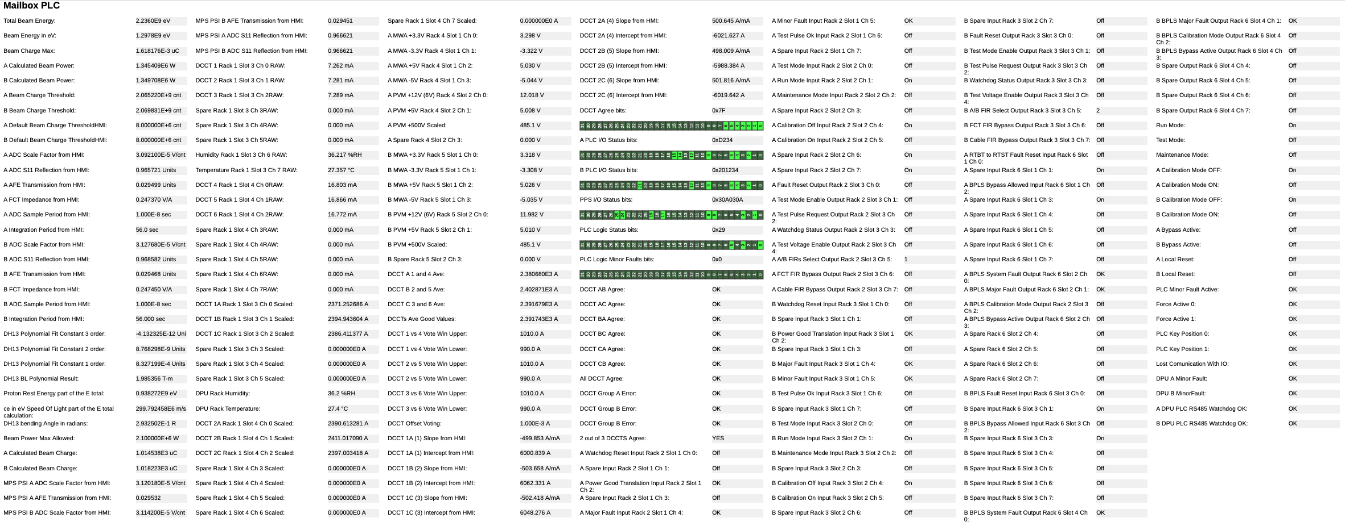
Creates tabular display of all tags
Only sophistication: Type DINT shown as hex number and bits
In this case, plain “engineering display” table was all that’s needed.

Slide 6

How?
Python scripts!
Fine print:
While it’s easy to start such helper scripts, they’re typically very specific to each given spreadsheet.
Small changes to the spreadsheet will break the conversion.
Column names, column order matter!
Comment “Don’t use this one!” or “Scale by 10!” in adjacent cell won’t be recognized by your script.
List of tags
Python script(s)
*.db
Display

Slide 7
Create *.db and displays from spreadsheets?
Useful from a certain number of tags on
Will reliably create records for all tags
Good enough for “engineering displays”, can be starting point for end user displays
Needs disciplined spreadsheet updates to prevent breaking the conversion

